Slide 1


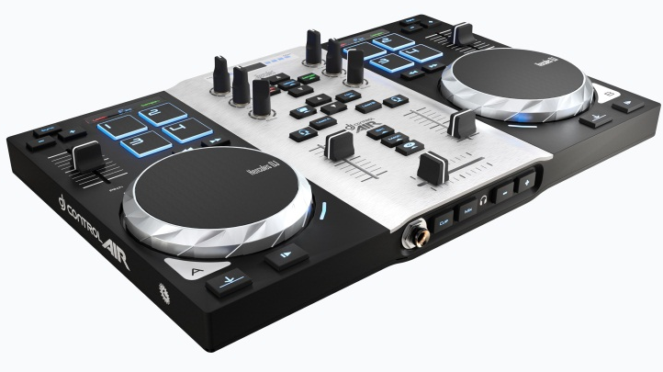
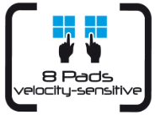

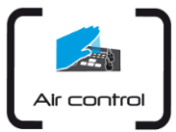
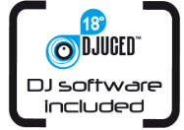
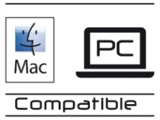

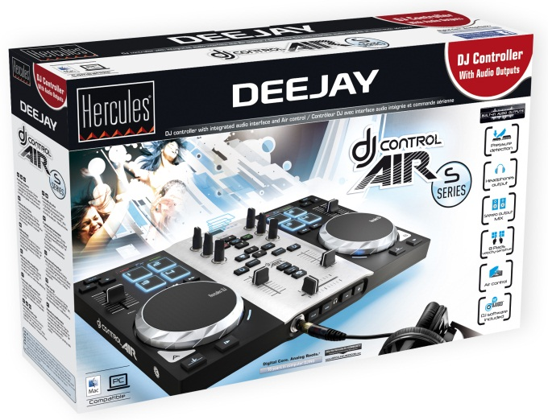

DJing
Technical specifications
USB DJ controller with audio outputs
2-deck DJ control surface Pressure-detecting jog wheels Contactless control for air mixing 8 progressive pads
Built-in audio 1/8” (3.5 mm) stereo output for the mix 1/4” (6.35 mm) stereo output for headphone previewing
DJ software: DJUCED 18° Intuitive, powerful software Mix 2 audio tracks on the fly Save your mix as an audio file
www.hercules.com
Mechanical specifications
Casing: 13.78 x 8.66 x 1.18 ” 35 x 22 x 3 cm
Jog wheels: 3.94 ” / 10 cm diameter
Weight: 3.1 lbs / 1.4 kg
USB cable: Attached
Minimum configuration
Computer with 2 GHz CPU or faster 1 GB RAM or more Powered USB port 100 MB available hard disk space CD/DVD-ROM drive Internet access Amplified stereo speakers and headphones Operating System (32-bit / 64-bit) Microsoft Windows® Vista, 7 or 8 or Mac OS 10.7, 10.8 or 10.9 on Core Duo Mac
New look for the DJ controller with touch and air controls
2-deck DJ controller
2 jog wheels with pressure detection
Velocity sensitive pads
Air control: 1 contactless control
Pressure-detecting jog wheels
Scratch by pressing on the jog wheels, as naturally
as with a vinyl record
Jog wheels also control pitch bend and browsing
within tracks
8 pads with velocity detection
The pads control the sampler, loops and effects
The inner backlight shows the pads’ activation
Pads can be set as binary On/Off controls, or gradual controls
Air control: a contactless sensor lets you control the mix from above, without even touching the device
DJ Control Air converts the distance to your hand into a MIDI command
No need to touch the controller: one command of the mix without any physical contact
Compatible with all light conditions
Built-in audio outputs for mixing and previewing tracks
1/8” (3.5 mm) stereo mini-jack output for the mix
1/4” (6.35 mm) stereo jack output for previewing tracks
Box contents
Hercules DJ Control Air S series Installation CD-ROM (PC/Mac) with PC/Mac DJ software Printed installation guide + online manual
Packaging specifications
Box 16.7 x 10.6 x 3.1 ” 42.4 x 27 x 8 cm
Master carton TBC
Units / carton 3
Pallet TBC
Reference Number / Barcode
EMEA: 4780771 / 3 362934744458
USA: 4780771 / 6 63296419637
Hercules DJ Control Air features a 2-year warranty.
Hercules® is a registered trademark of Guillemot Corporation S.A. Microsoft® Windows® Vista , 7 and 8 are registered trademarks of Microsoft Corporation in the United States and/or other countries. Intel® Core™ are trademarks of Intel Corporation. Apple®, the Apple logo and Mac OS® are registered trademarks of Apple Computer, Inc. All other trademarks and brand names are hereby acknowledged and are property of their respective owners. Illustrations not binding.
Your contact:
xxxxxxxxxxxxxxxxxxxxxxx

Slide 2
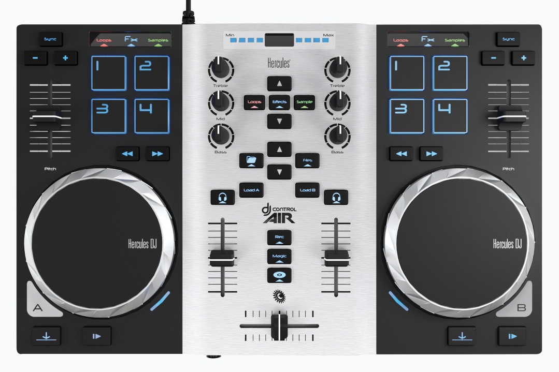
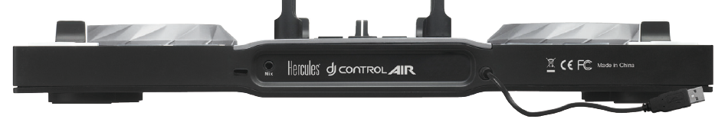
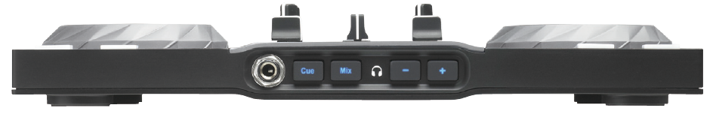
DJing
www.hercules.com
4 pads Contactless sensor 4 pads
2.0
Pressure-detecting Pressure-detecting
jog wheel jog wheel
1/8” (3.5 mm) stereo mini-jack output on the rear for the mix
1/4” (6.35 mm) stereo jack output for previewing tracks
Reference Number / Barcode
EMEA: 4780771/ 3 362934744458
USA: 4780771 / 6 63296419637
Hercules DJ Control Air features a 2-year warranty.
Hercules® is a registered trademark of Guillemot Corporation S.A. Microsoft® Windows® Vista , 7 and 8 are registered trademarks of Microsoft Corporation in the United States and/or other countries. Intel® Core™ are trademarks of Intel Corporation. Apple®, the Apple logo and Mac OS® are registered trademarks of Apple Computer, Inc. All other trademarks and brand names are hereby acknowledged and are property of their respective owners. Illustrations not binding.
Your contact:
xxxxxxxxxxxxxxxxxxxxxxx

Slide 3

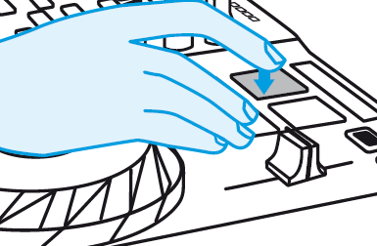
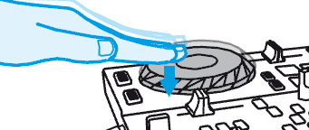
DJing
www.hercules.com
Air control
Why is the controller called DJ Control Air?
Air stands for Adjustment by InfraRed: it is a contactless control.
The DJ places his or her hand flat over the infrared beam.
The controller calculates the distance between the sensor and the hand, and converts it into a gradual MIDI command.
This MIDI command modulates a setting in the DJ software.
Does Air control require specific light conditions?
No, Air control functions under any light conditions.
The infrared light beam projected towards the hand is invisible.
The sensor captures the infrared reflection on the hand, and uses the reflection to calculate the hand’s distance.
The reflection is the same in both daylight and low light conditions, allowing Air control to be used during the day, at night or in places with weak lighting.
Air control functions with all flesh tones. The only incompatibility is the use of black gloves (as the infrared sensor would not be able to detect the reflection).
8 pads
2 sets of 4 pads control loops, sampler and effects commands.
The DJ taps on the pads with his or her fingertips to send commands such as looping, sampler or effects.
The pads light up when touched.
In addition to a binary On/Off command, each pad can transfer velocity information to modulate the command.
For example: in sampler mode, the velocity can control the volume of a sample’s playback. The playback volume depends on how soft or how hard the DJ taps on the pad.
Pressure-detecting jog wheels
The jog wheels detect the pressure from the user’s hand.
With scratch mode enabled, the jog wheels scratch when the hand’s weight is detected, and stop scratching when the hand’s weight is no longer detected. This allows the DJ to:
  stop playback by pressing on the jog wheel.
  restart playback by lifting up his or her hand.
  scratch by turning the jog wheel while pressing down, and stop scratching by lifting up his or her hand.
  bend the pitch (if playback is on) / browse within tracks (if playback is off) by turning the jog wheels using their outer ring, to avoid applying downward pressure.
With scratch mode disabled, the jog wheels bend the pitch or browse within tracks when the jog wheels are turned, regardless of the pressure applied.
2.0
Reference Number / Barcode
EMEA: 4780771/ 3 362934744458
USA: 4780771 / 6 63296419637
Hercules DJ Control Air features a 2-year warranty.
Hercules® is a registered trademark of Guillemot Corporation S.A. Microsoft® Windows® Vista , 7 and 8 are registered trademarks of Microsoft Corporation in the United States and/or other countries. Intel® Core™ are trademarks of Intel Corporation. Apple®, the Apple logo and Mac OS® are registered trademarks of Apple Computer, Inc. All other trademarks and brand names are hereby acknowledged and are property of their respective owners. Illustrations not binding.
Your contact:
xxxxxxxxxxxxxxxxxxxxxxx

